Slide 1
Lead Classification Project by / Omar Khaled Abdel Hafez

Slide 2
Problem

Slide 3
Problem Context
In Nawy we are initiating targeting campaigns on a daily basis to generate Real estate leads.
The main pain is generating qualified leads.So we need to build a model to classify the received
leads into two categories: low qualified and high qualified leads.

Slide 4
Dataset
Column Name | Description
lead_id | Is unique id representing customer (customer my reach more than one time)
customer_name | Name of the customer
lead_mobile_network | To differentiate between local and international customers
message | Message left by the customer
lead_time | Time of receiving the lead
method_of_contact | Contact method used to reach us
ad_group | Include information of target audience used in the campaign
lead_source | Channel used to reach us
campaign | Name of the targeting campaign
Location | The location which the customer is searching for
Low_qualified | Define if the lead is low or high qualified

Slide 5
EDA & Preprocessing

Slide 6
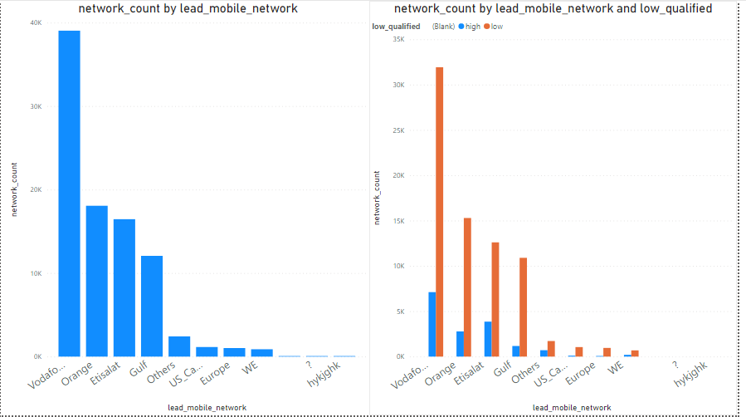
Lead mobile network

Slide 7
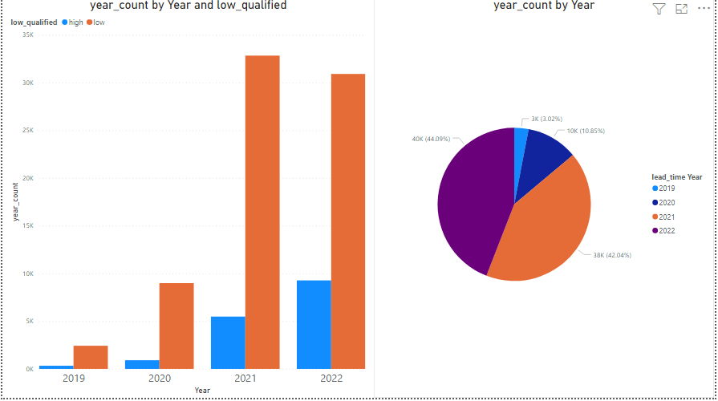
Lead time

Slide 8
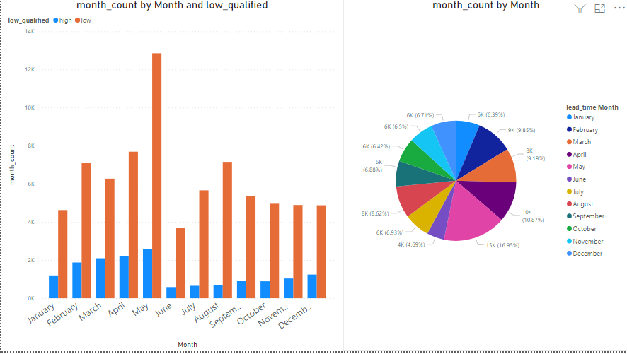
Lead time

Slide 9
lead source
have many values with the same source like ( facebook , fb , fb page )
Need to collect all values that have the same source by hand and cluster them

Slide 10
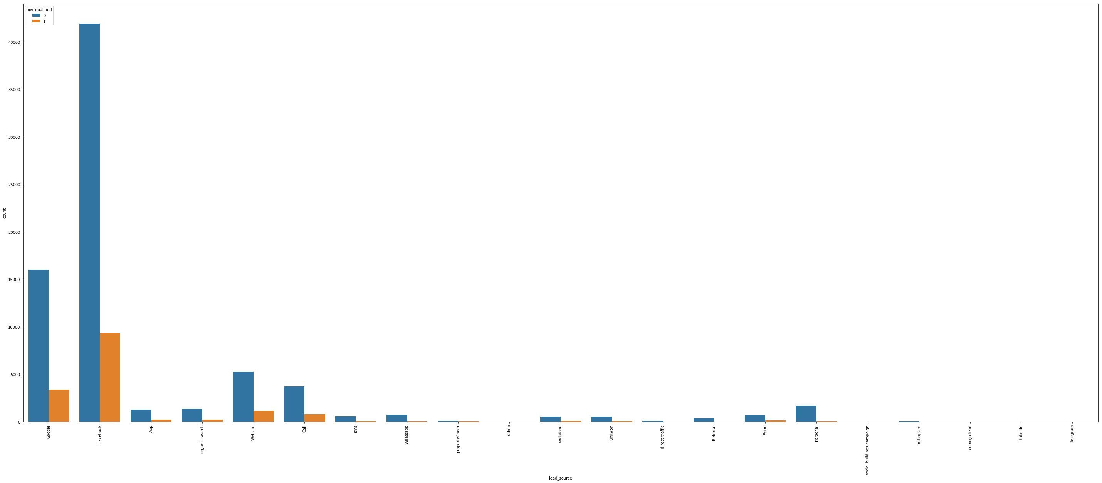
lead source

Slide 11
Method of contact
have many values with the same source like ( facebook , fb , fb page )
Need to collect all values that have the same source by hand and cluster them

Slide 12
Campaign
here i can't apply the idea of hand cluster it so big and have 2481 unique values , so i tried to study them will and try to cluster them in groups based on reach so each ad_group make high reach , meduim or low
i tried to choose reach values carefully to make balance in the count of lead in each group so after try alot i will decided the values
High value > 500 except none values
Meduim from =< 500 & > 100
Low any value less than 100

Slide 13
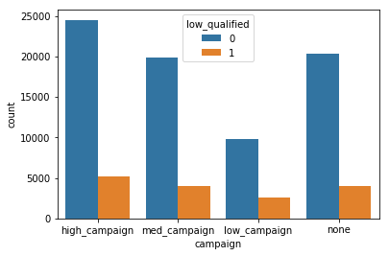
Campaign

Slide 14
Ad group
here i can't apply the idea of hand cluster it so big and have 2481 unique values , so i tried to study them will and try to cluster them in groups based on reach so each ad_group make high reach , meduim or low
i tried to choose reach values carefully to make balance in the count of lead in each group so after try alot i will decided the values
High value > 350 except none values
Meduim from =< 350 & > 100
Low any value less than 100

Slide 15
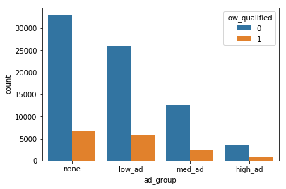
Ad group

Slide 16
Other columns
All other columns undneed for our case
Only location can be use but due to time can’t find best way to use it

Slide 17
Model phase

Slide 18
Feature Engineering
use label encoding to encode all categorical data into numbers in many times using one hot encoding is better as when u use label encoding model may understand that 4 is big than 2 and we don't need that but one hot encoding will make our data has big number of dimensions
i will use label encoding to save dimensions number and get the advantage of tree based model which can work will with categorical data also don't need to normalize or scaling data
Also tree based work well with imbalance data

Slide 19
imbalance data
The data set have very big imbalance class almost 90% to 10 %
i try to solve this problem throw three ways

Slide 20
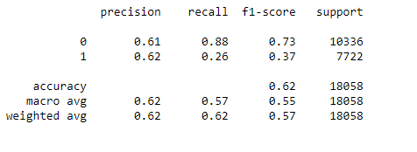
1- Data :
under sampling

Slide 21
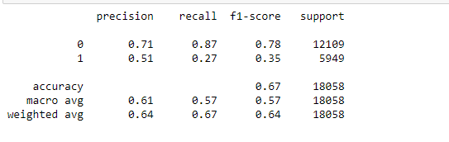
1- Data :
over sampling using smote

Slide 22
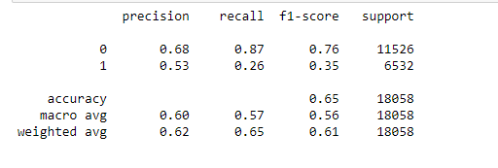
1- Data :
try to make mix between two methods (doing over by ratio then make under sample )

Slide 23
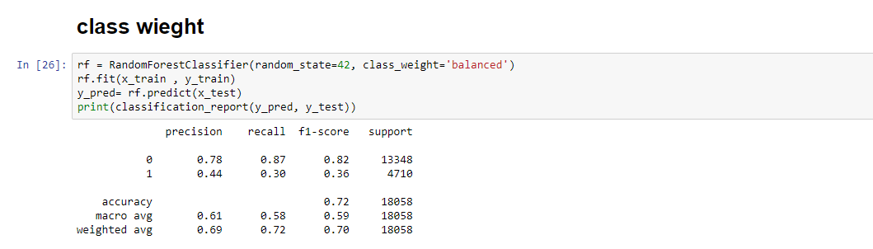
1- model :

Slide 24
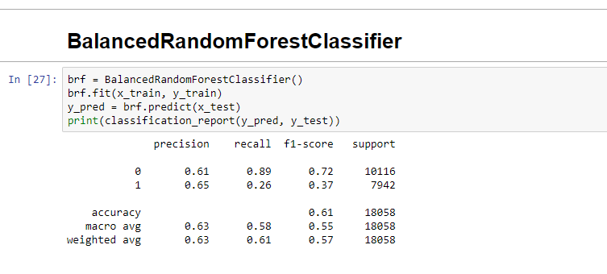
1- model :

Slide 25
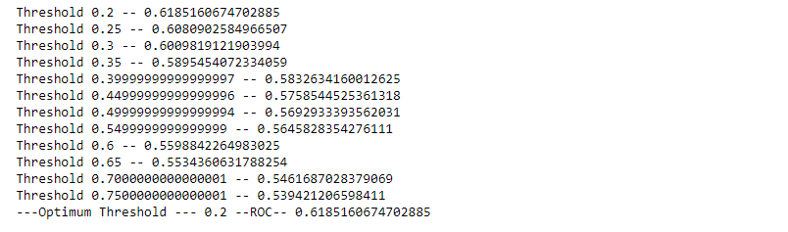
1- model :
Threshold moving

Slide 26
Next Steps

Slide 27
Next Streps
Study location columns well and try to find pattern to use it
Try to use massage columns
Use gridsearchCV
Use boosting like (Xgboost , gradient boosting )

